Slide 1
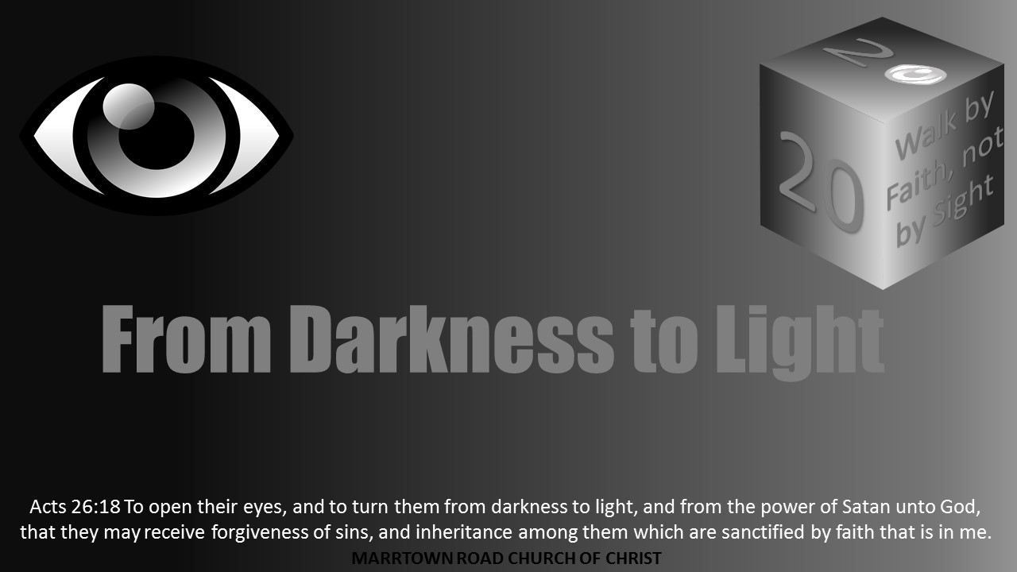


Slide 2
Light Lesson 7 Opening the Eyes of Our Heart

Slide 3
Introduction
Have you ever seen something worth an enormous amount of money that looked like junk to you?
I remember walking into an art museum and seeing one of their prized works: a large, empty canvas with a single tear going down the center.
I remember being shocked and disappointed that something anyone could easily replicate was being heralded as extraordinary.
Even if it had been offered to me for free, I would have thought I was being offered someone’s garbage.

Slide 4
Introduction
Despite how I saw it, my view was clearly not the determination of the value or importance of that piece of art.
What do you think is the difference between someone who could appreciate it compared to my view?
When we set our eyes on that canvas, we saw the same thing in two very different ways.
I quickly walked away disappointed and frustrated, while others would stand for some time and think deeply in ways triggered by the work.
They may even have had a profound realization that could potentially change their perspective in some way that I did not experience simply because my way of thinking was not aligned to value it as they did.

Slide 5
Introduction
Someone may have seen the work differently because they took the time to consider the artist and his or her intentions behind the work.
Or, they may have had a life experience that caused them to connect to the message communicated by the work—even if it was not the message the artist intended to send.
Whatever it was, I did not see what they were seeing.

Slide 6
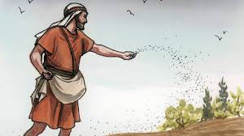
The Nature of Parables
In Matthew 13, Jesus began to teach many things to the crowds in parables, which became a common form of teaching in His ministry.
Parables by definition are used to illustrate something profound and difficult to grasp by comparing and relating it to things that are simple and common.
For example, in Matthew 13:3-9 Jesus speaks of a sower who was throwing his seed onto different soils, which affected the seed’s development differently. Initially, Jesus gave no explanation and made no indication that this simple story was key to understanding the glory of God’s eternal kingdom.

Slide 7
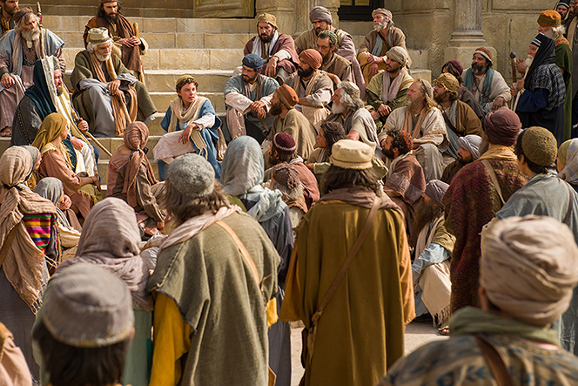
The Nature of Parables
In Luke 2:46-47, even at twelve years old, Jesus was able to amaze the teachers of Jerusalem with His understanding and answers.
In Matthew 7:28-29, the crowds were amazed at Jesus’ teaching.
In John 7:46, officers sent to seize Jesus told those who had sent them, “Never has a man spoken the way this man speaks.”
In Luke 24:32, two disciples whom Jesus had “explained to them the things concerning Himself in all the Scriptures” said, “were not our hearts burning within us while He was speaking to us on the road, while He was explaining the Scriptures to us?”

Slide 8
The Nature of Parables
If Jesus had such mastery in His understanding of the Old Testament Scriptures so that He could easily amaze even the most well-studied student of God’s word, why would He choose to frequently teach in a way that was so simplistic and unattractive?
The disciples asked the same question in Matthew 13:10. Jesus explained to them, “To you it has been granted to know the mysteries of the kingdom of heaven, but to them it has not been granted. For whoever has, to him more shall be given, and he will have abundance; but whoever does not have, even what he has shall be taken away from him. Therefore I speak to them in parables; because while seeing they do not see, and while hearing they do not hear, nor do they understand. In their case the prophecy of Isaiah is being fulfilled, which says, ‘You will keep on hearing, but you will not understand; you will keep on seeing, but will not perceive; for the heart of this people has become dull, with their ears they scarcely hear, and they have closed their eyes, otherwise they would see with their eyes, hear with their ears, and understand with their heart and return, and I would heal them.’” (Matt 13:11-15 NASB).

Slide 9

The Nature of Parables
Jesus’ parables were like that ripped canvas.
Some would come to Jesus hoping to hear or see something spectacular, only to be disappointed by what seemed to be simple, meaningless short stories.
While they would walk away unchanged, others would see God’s kingdom in an entirely new light.
What causes such a dramatic difference?

Slide 10
Seeing the Teacher
Notice Jesus’ first statement in explaining why He taught in parables.
“To you it has been granted to know…”
Who is the “you” Jesus is speaking to? He was answering the disciples who came to Him seeking an understanding of the parable of the sower.
“They” who were fulfilling Isaiah’s prophesy were those who were not disciples.

Slide 11
Seeing the Teacher
Why would being a disciple of Jesus make such a difference in how His parables would be received?
Having developed a knowledge and respect for the artist behind the ripped canvas would have caused a totally different way of seeing and valuing that work.
So many works of art that could easily be replicated have value because of the person who created them.
So often the value of things that seem common transforms completely because of the person they are associated with.

Slide 12
Seeing the Teacher
It is so important to understand what led so many disciples to dedicate themselves to following Jesus.
In John 1:34, John the Baptist testified of Jesus, “This is He on behalf of whom I said, ‘After me comes a Man who has a higher rank than I, for He existed before me.’ He then also said that Jesus was, “the Son of God.” And in verse 35 John sees Jesus and calls Him “the Lamb of God.”
Because of this testimony from John, Andrew follows Jesus and tells his brother Peter, “We have found the Messiah.”
Philip, another disciple, found Nathanael and said to him, “We have found Him of whom Moses in the Law and also the Prophets wrote—Jesus of Nazareth, the son of Joseph.”
When Nathanael came to Jesus, he confessed of Him, “Rabbi, You are the Son of God; You are the King of Israel.”

Slide 13
Seeing the Teacher
Since the time Jesus began His public ministry in Matthew 4:17, His core message was, “Repent, for the kingdom of heaven is at hand.”
They saw Him heal the sick, cast out demons, heal lepers, and even raise the dead (Matt 11:4-5).
However, in Matthew 11:16-19, Jesus spoke of those who saw these things but were still unimpressed and unsatisfied.
In Matthew 11:20-24, He further spoke against “the cities in which most of His miracles were done, because they did not repent.”
To those whose spiritual eyes had been opened by Jesus, His parables would open their eyes further to see the glory of His kingdom.
To those whose eyes were still blind through refusal to repent, His parables would only blind them further.

Slide 14

Seeing the Teacher
What I see in Jesus’ parables is ultimately a reflection of how I see Jesus Himself.
If I see Jesus as He truly is, then I can know His teaching, in whatever form it takes, holds truths of greater value than any earthly thing.
I become both willing and capable to meditate on the stories of the parables and how they relate to and reveal the greater spiritual realities Jesus came to embody and represent.

Slide 15
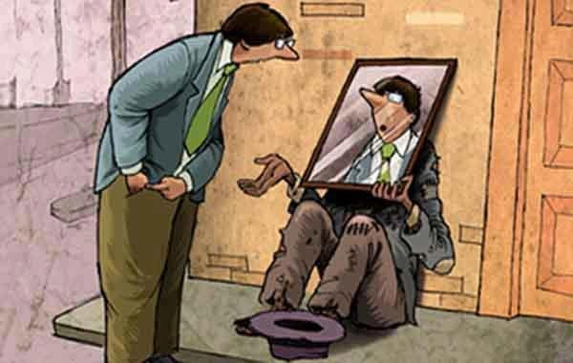
Seeing Myself
But parables are not just about seeing Jesus and His kingdom, they reveal your own condition as well.
Notice back in Matthew 13:15, the final part of Isaiah’s prophesy that is quoted says that if “they” understood with their heart, they would “return, and I would heal them.”
Those disciples who had repented had been convicted of their sins did so through believing that His words both revealed spiritual deadness and gave spiritual life.
As Jesus said when eating among sinners in Matthew 9:12-13, “It is not those who are healthy who need a physician, but those who are sick. But go and learn what this means: ‘I desire compassion, and not sacrifice,’ for I did not come to call the righteous, but sinners.”

Slide 16
Seeing Myself
Jesus’ first parable in Matthew 13 even speaks to this end.
When Jesus explains the parable of the sower in Matthew 13:18-23, He reveals that the four soils are four heart conditions and each receives the word differently.
These truths do not just equip me to understand the conditions of heart that exist in others, but it helps me to understand the condition of my own heart.

Slide 17
Seeing Myself
A brilliant component in this teaching is that I am given the option of whether or not I will associate my own heart with any of these conditions.
This not only challenges how honest and open I am willing to be with myself and with God but also whether or not I have been humbled to appreciate how corrupt the condition of my heart has become by my sin.
To see God’s glory more clearly, I need God to dramatically change my heart.

Slide 18

Seeing Myself
In Mark and Luke’s account of the same parable, Jesus immediately follows His explanation in Luke 8:16-18 by saying, “Now no one after lighting a lamp covers it over with a container, or puts it under a bed; but he puts it on a lampstand, so that those who come in may see the light. For nothing is hidden that will not become evident, nor anything secret that will not be known and come to light. So take care how you listen; for whoever has, to him more shall be given; and whoever does not have, even what he thinks he has shall be taken away from him.”

Slide 19
Seeing Myself
In Psalm 139:23-24, David applied this same principle when he said, “Search me, O God, and know my heart; try me and know my anxious thoughts; and see if there be any hurtful way in me, and lead me in the everlasting way.”
How are you listening?
Are you willing to give God permission to search through your heart, as a lamp gives light where there was once darkness?
Parables are the means through which our hearts are refined and purified by coming to see and search my heart as it is seen and searched by God.
“Blessed are the pure in heart, for they shall see God.” (Matt 5:8 NASB).

Slide 20

The Eye is the Lamp
In Luke 17:20-21, when the Pharisees came to Jesus asking when the kingdom of God was coming, “He answered them and said, “The kingdom of God is not coming with signs to be observed; nor will they say, ‘Look, here it is!’ or, ‘There it is!’ For behold, the kingdom of God is in your midst.”
If the kingdom of God was in their midst, why could they not see it?

Slide 21

The Eye is the Lamp
In Luke 11:33-35, Jesus uses the same illustration He used after He taught the parable of the sower, of the lamp being set on a lampstand.
But here He then continues further and says, “The eye is the lamp of your body; when your eye is clear, your whole body is also is full of light; but when it is bad, your body also is full of darkness. Then watch out that the light in you is not darkness. If therefore your whole body is full of light, with no dark part in it, it will be wholly illumined, as when the lamp illumines you with its rays.”
As difficult as it is to grasp or define what exactly Jesus means here, Luke immediately follows this teaching with an interaction that serves to illustrate it.

Slide 22

The Eye is the Lamp
In Luke 11:37-38, Jesus dines with a Pharisee who is shocked when he sees that Jesus did not ceremonially wash His hands before the meal.
His shock at seeing this reveals something deeper that Jesus then speaks to—“Now you Pharisees clean the outside of the cup and of the platter; but inside of you, you are full of robbery and wickedness. You foolish ones, did not He who made the outside make the inside also?” (Luke 11:39-40 NASB).

Slide 23
The Eye is the Lamp
Because the eyes of the Pharisees were bad, they were filled with darkness and could not recognize the glory of the kingdom of God even while it was right before them.
The problem was not that the kingdom of God was not apparent enough or that it was not being made clear enough by Jesus.
The problem was the Pharisees were totally blind because of the darkness within them.
But what caused their eyes to be so blind?

Slide 24
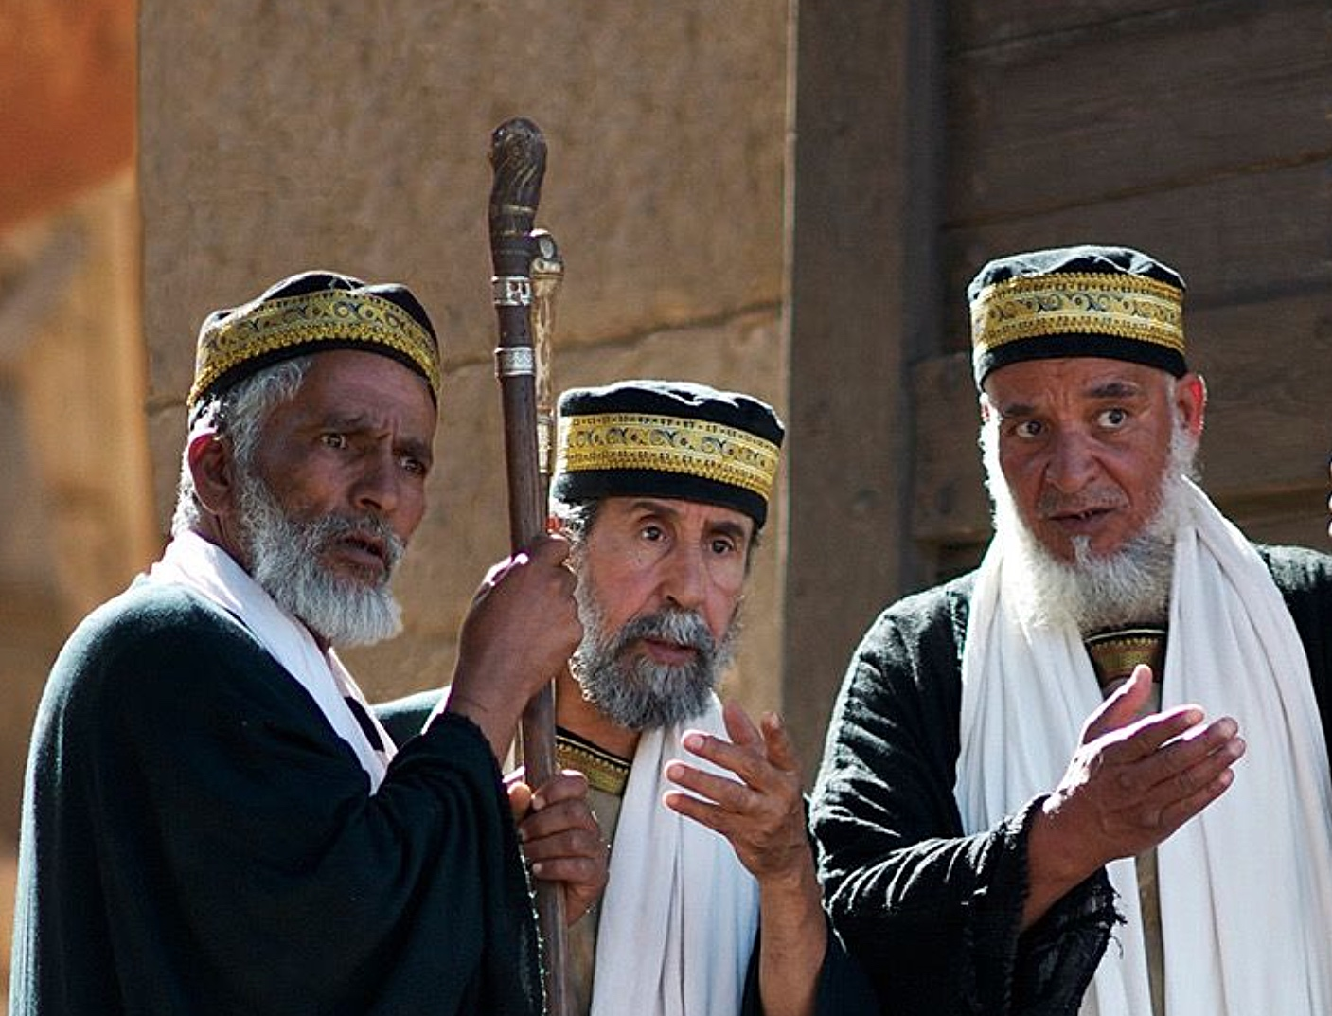
The Eye is the Lamp
The Pharisees were so focused on the external; they could not perceive what was spiritual.
When Jesus ate with a Pharisee, the Pharisee was shocked when he saw Jesus did not clean His hands ceremonially, but yet he was not shocked at the exposure of how unclean he was in his heart.
The Pharisees presumed they were living embodiments and examples of God’s Law.
Whereas the intention of that Law had always been to expose the reality of the enormity of the corrupting power of sin, in order to lead to the heart to which the parables appealed.
If I understand, as Jesus said, when my eye is bad my body is “full of darkness,” then I in shock and horror can exclaim like Paul in Romans 7:24, “Wretched man that I am! Who will set me free from the body of this death?”

Slide 25

Can’t You See It?
But being blind to things of the heart and the Spirit was not just a problem someone like a Pharisee had.
After miraculously feeding four thousand people in “a desolate place,” Jesus and His disciples get on a boat with only one loaf of bread.
When Jesus then warns them to watch out for the “leaven” of the Pharisees and of Herod, they argue about the fact they have no bread.
Jesus challenges them, saying, “Why do you discuss the fact that you have no bread? Do you not yet see or understand? Do you have a hardened heart? Having eyes, do you not see? And having ears, do you not hear?” (Mark 8:14-21 NASB).

Slide 26
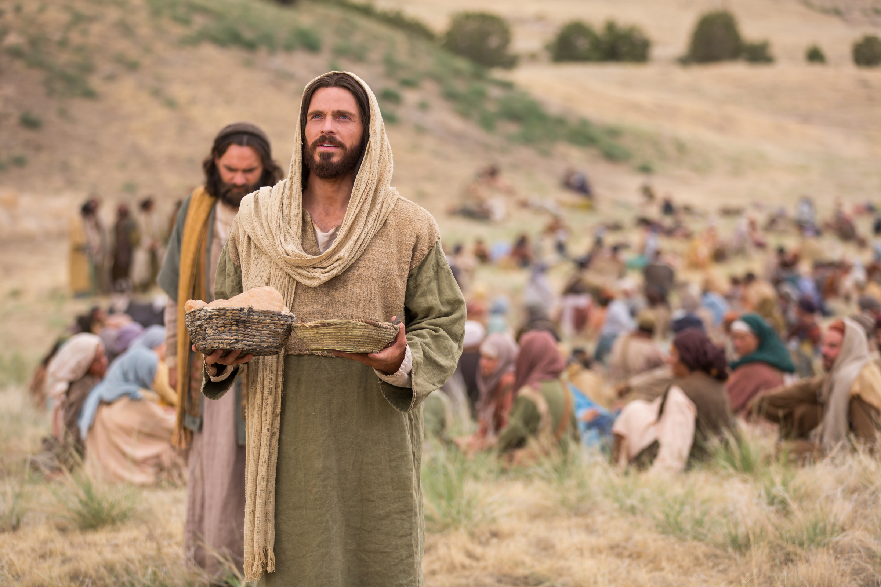
Can’t You See It?
Jesus proceeds to admonish His disciples that there was more they should have been seeing from His miracles.
Just like the Pharisees, their focus was still set on the wrong things even though they had previously experienced the kind of convictions that should have caused their eyes to be completely open!
But like the parables, it would be so easy to take for granted there are greater, more permanent lessons intended in Jesus’ miracles that are meant to open my eyes and change my heart.
If all we see when Jesus miraculously feeds thousands of people is a confirmation of His deity and evidence of His compassion, our eyes have not been opened either.

Slide 27

Can’t You See It?
It is not just that Jesus taught in parables; it is that all of Jesus’ works were living parables.
Jesus' intention in feeding the crowds was meant to radically change their “eye.”
His intent was to shift their concerns from their personal, physical needs and to put their focus on the greater urgency of spiritual needs.
In Mark 8:19-20, Jesus forced them to think again about the feeding of the crowds because they still had not truly seen those miracles despite experiencing them so intimately

Slide 28
Can’t You See It?
How about you?
Did you realize you were meant to be so deeply changed by those two miracles? Did you see it?
If we can learn to wrestle with parables and be inwardly, permanently changed by the lessons God opens our eyes to see, we can see and follow Jesus “with unveiled face, beholding as in a mirror the glory of the Lord,” and be “transformed into the same image from glory to glory, just as from the Lord, the Spirit.” (2 Cor 3:18 NASB).

Slide 29
Can the Blind Get to Heaven?
Paul, to the church in Corinth further said, “And even if our gospel is veiled, it is veiled to those who are perishing, in whose case the god of this world has blinded the minds of the unbelieving so that they might not see the light of the gospel of the glory of Christ, who is the image of God. For we do not preach ourselves but Christ Jesus as Lord, and ourselves as your bond-servants for Jesus’ sake. For God, who said, “Light shall shine out of darkness,” is the One who has shone in our hearts to give the Light of the knowledge of the glory of God in the face of Christ.” 2 Corinthians 4:3-6.

Slide 30
Can the Blind Get to Heaven?
The times we have seen Jesus referring to the blind have been those whose minds the “god of this world has blinded.”
If you are blinded by the values and pleasures of this present life, then the value and glory of eternal life will be impossible to see as reality.
If you cannot see God’s righteousness reflected in His Son, you will never see your unrighteousness in a way that will cause you to have a broken and contrite heart.
If you cannot see in yourself thoughts and motives deserving God’s judgment and wrath, you will not see the glory of His own thoughts and motives He offers to replace them.
If you cannot see the vast glory of discovering greater heights of God’s kingdom through the simplicity of Jesus’ parables, then you cannot see at all.

Slide 31

Can the Blind Get to Heaven?
In Revelation 22:4, God promises those who are with God eternally will “see His face.”
But, it is not just a fact they will see His face; they had already been living in the light of His face reflected through their Lord Jesus Christ.
As David said so long ago, “One thing I have asked from the Lord, that I shall seek: That I may dwell in the house of the Lord all the days of my life, and to behold the beauty of the Lord and to meditate in His temple. When You said, “Seek My face,” my heart said to You,” Your face, O Lord, I shall seek.” (Ps 27:4, 8 NASB).
May God help us to meditate on Jesus’ parables in a manner that causes us to behold the beauty of His face and further seek to dwell with Him where He is, as He is.

